Slide 1

ACCIDENT TRACKING AND RESCUE SYSTEM
B.Tech ECE FINAL YEAR PROJECT - FINAL REVIEW
BY:
Katam Pavan Kumar Reddy - 18BEC0665
Shiva Sai Anuraag Nalam - 18BEC0657
K J Deepak Somesh - 18BEC0920
Under the Guidance of
PROF. RAJESH N

Slide 2

MOTIVATION
Road accidents, a well known word to most of the people irrespective of the age group. There are different scenarios where people die due to road accidents such as not following the safety measures, failure of parts in vehicle, improper roads, not having proper medical treatment in time and so on.
There are many ways to avoid being hit by an accident but even though all the proper measures were taken to avoid them, there are some unexpected situations which in turn leads to road accidents.
Because of this, there is a need for a device which is helpful for detection of road accident and the information has to be sent to the respective authorities to save the lives of people.

Slide 3

CURRENT STATUS AND FINDING THE GAP
We have different methodologies to find the detection of a road accident but our model we have created stands out from the other models where the model we have created can detect the road accident as well as the side tilt of a vehicle at the accident location which in turn helps furter to equip the necessary medical facilities to reach the accident spot. Along with this we have installed a buzzer which will create a sound to let the other people at the nearby locality to get to know about the accident and they may take care of the initial first aid.

Slide 4
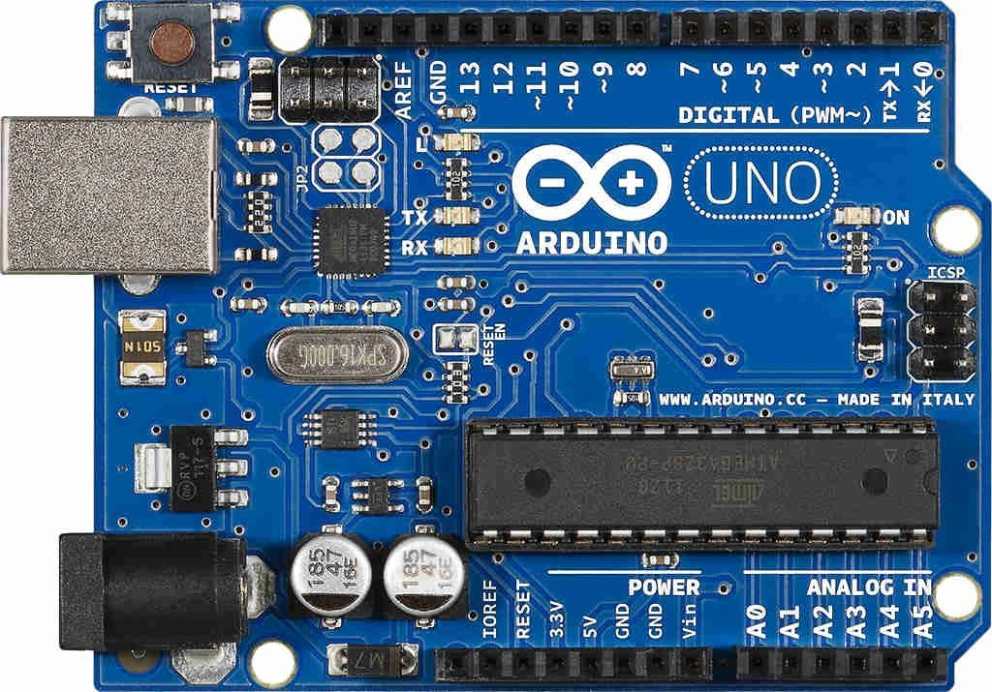
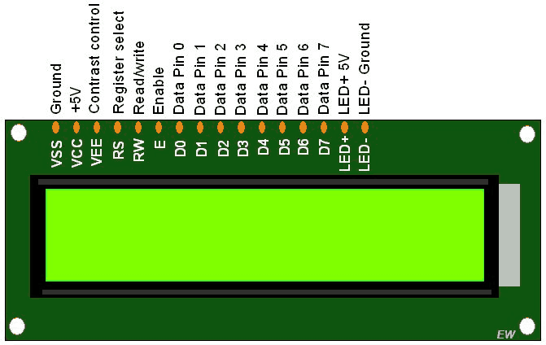
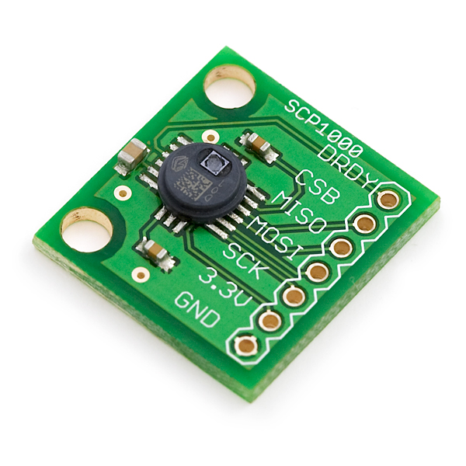
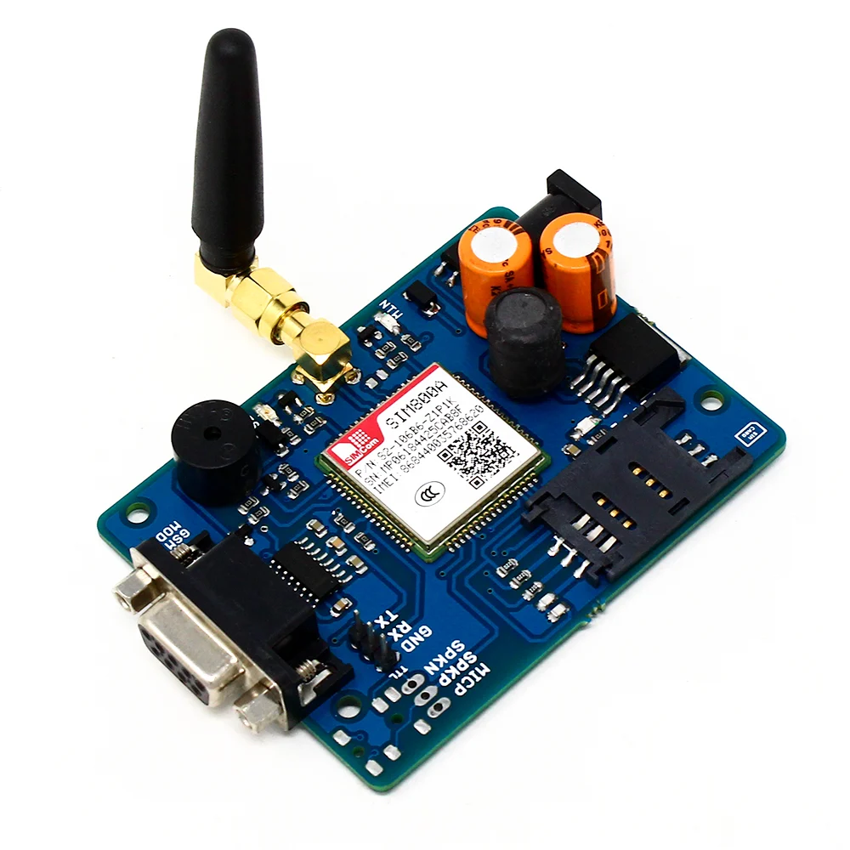
HARDWARE/SOFTWARE DETAILS
ARDUINO UNO: A microcontroller based on ATmega328. It has 14 digital input/output pins, 6 analog input pins, a 16MHz ceramic resonator, a USB connection, a power jack, an ICSP header, and a reset button.
LCD/DISPLAY: Liquid Crystal Display also called as LCD is very helpful in providing user interfaces as well as for debugging purpose. A 16x2 LCD display is very basic module and is very commonly used in many devices and circuits.
MEMS SENSOR: These sensors are used to detect as well as measure the external stimulus like pressure, after that it responds to the pressure which is measured pressure with the help of some mechanical actions.
GSM: GSM is a mobile communication modem.
WIFI: A wireless network uses radio waves, just like cell phones, televisions and radios do.
ARDUINO SOFTWARE: Arduino IDE is required to program the Arduino UNO board.

Slide 5

OBJECTIVE
The objective of this paper is to set in place a fully automated system design that will minimize the time gap between the occurrence of an accident and deployment of medical response. This can be done by combining accident detection and Emergency Medical Services systems.
The proposed design makes use of an accelerometer and a piezoelectric sensor to trigger the microcontroller, which retrieves the user’s location through the GPS. Communication between the IOT device an the database is done using GSM/GPRS module. An Android app is designed to collect the relevant health information of the user, emergency contact information, and hospital details during initial registration.

Slide 6
METHODOLOGY
Whenever the tilt is applied to the MEMS sensor, then a balanced mass makes a difference within the electric potential. This can be measured like a change within capacitance. Then that signal can be changed to create a stable output signal in digital, 4-20mA or VDC.
These sensors are fine solutions to some applications which do not demand the maximum accuracy like industrial automation, position control, roll, and pitch measurement, and platform leveling.
The SIM card mounted GSM modem upon receiving digit command by SMS from any cell phone send that data to the MC through serial communication. While the program is executed, the GSM modem receives command ‘STOP’ to develop an output at the MC, the contact point of which are used to disable the ignition switch. The command so sent by the user is based on an intimation received by him through the GSM modem ‘ALERT’ a programmed message only if the input is driven low. The complete operation is displayed over 16×2 LCD display.

Slide 7
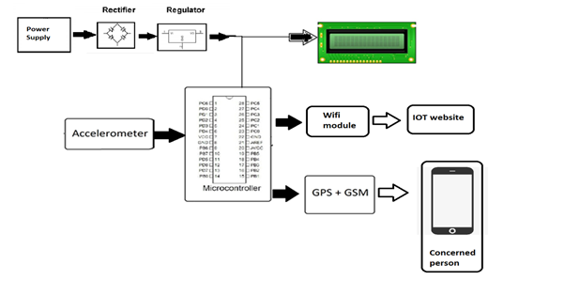
BLOCK DIAGRAM

Slide 8
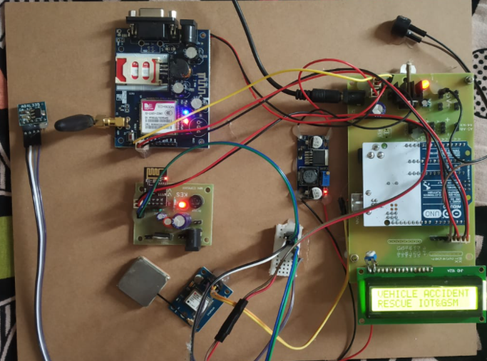
RESULTS
This is the main outline of the project where we can see a display on the LCD screen (Stating as VEHICLE ACCIDENT AND RESCUE IOT AND GSM) when we switch on the power supply.

Slide 9
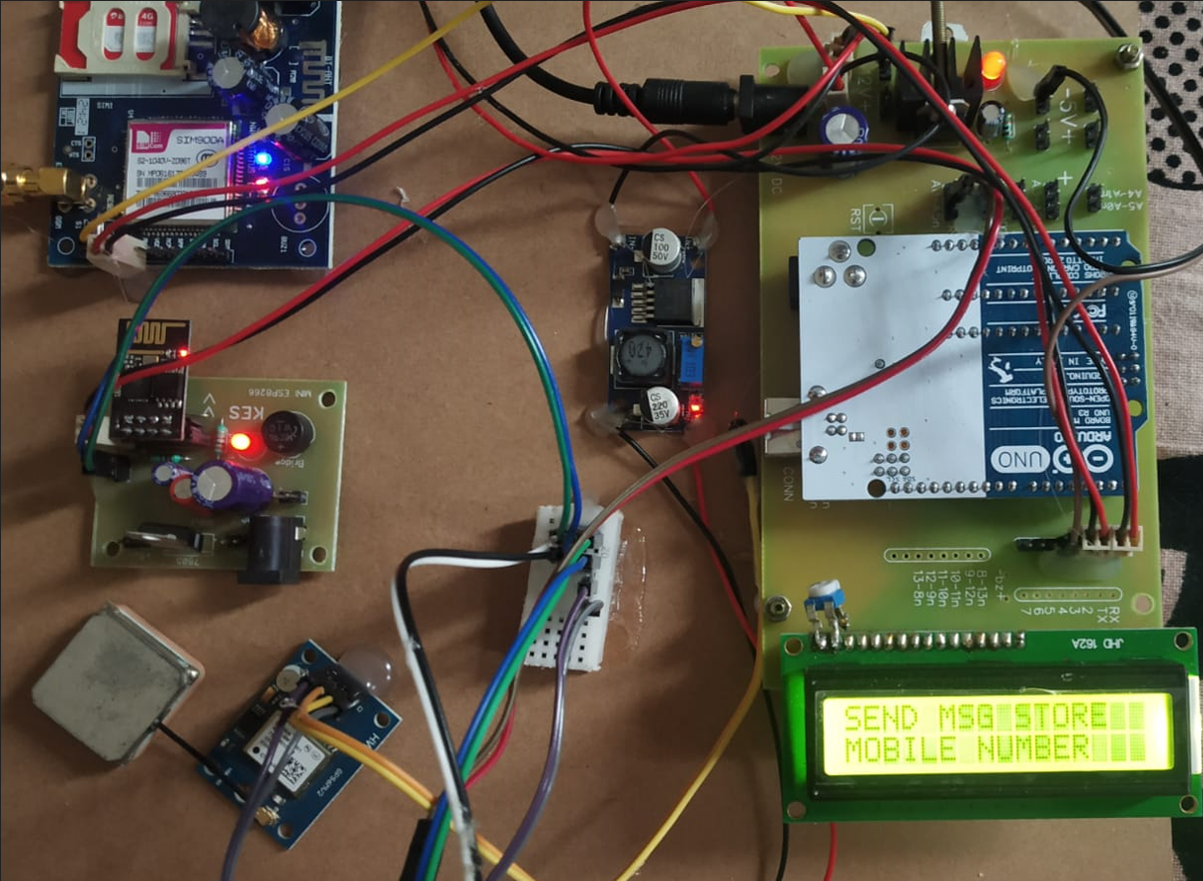
After that we need to send the mobile number (which we want to register) to the sim card which is placed in the GSM module

Slide 10
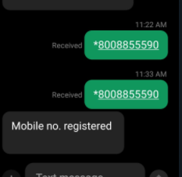
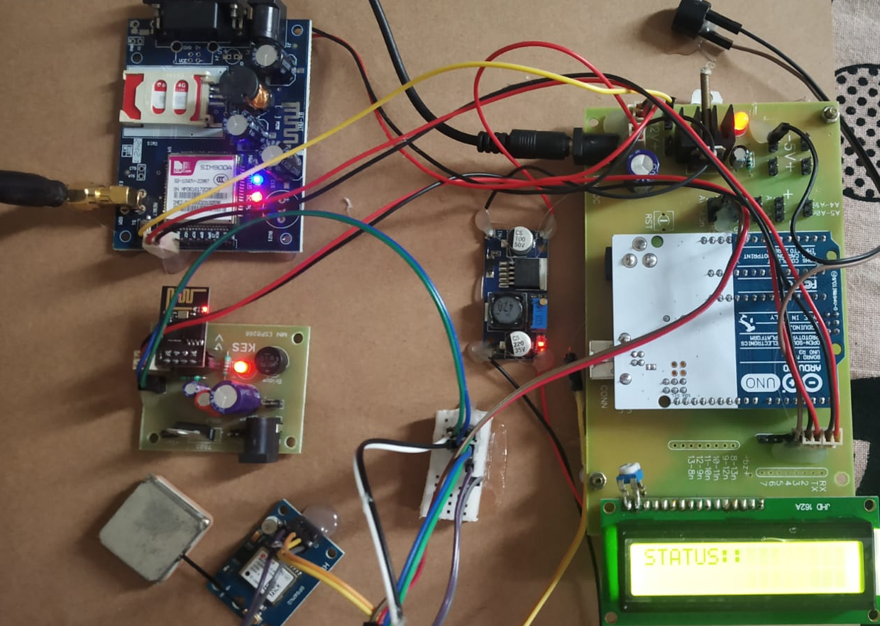
After sending the mobile number which we want to register to the GSM module, we will receive a message stating that the mobile number is registered and LCD screen will display as STATUS:

Slide 11
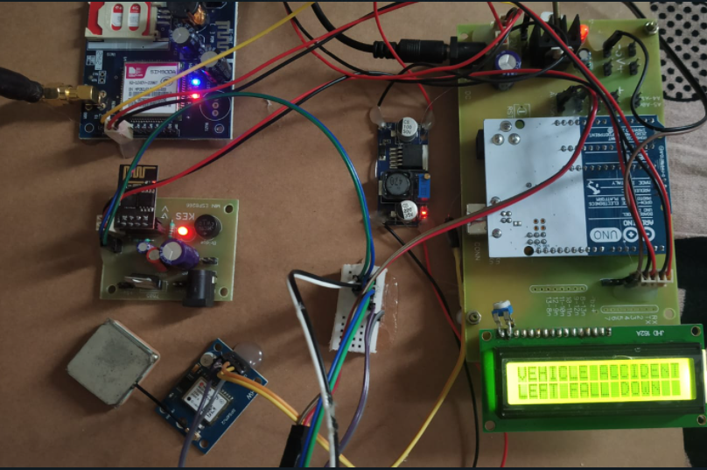
Then we need to connect the phone and the wifi module using mobile telnet app where we will receive messages both in telnet app as well as in the normal messenger.Then accordingly the LCD will display the direction of the occurrence of the accident

Slide 12
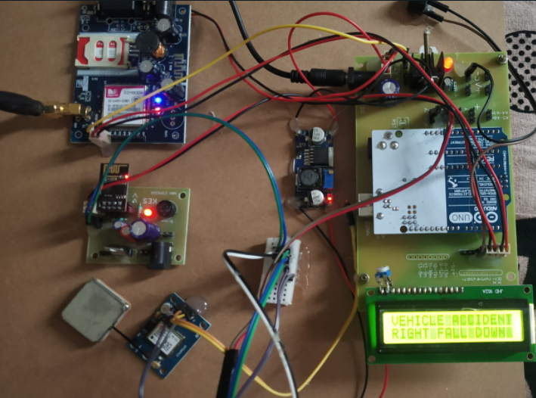
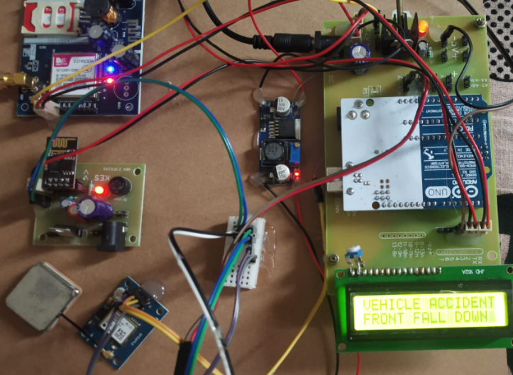
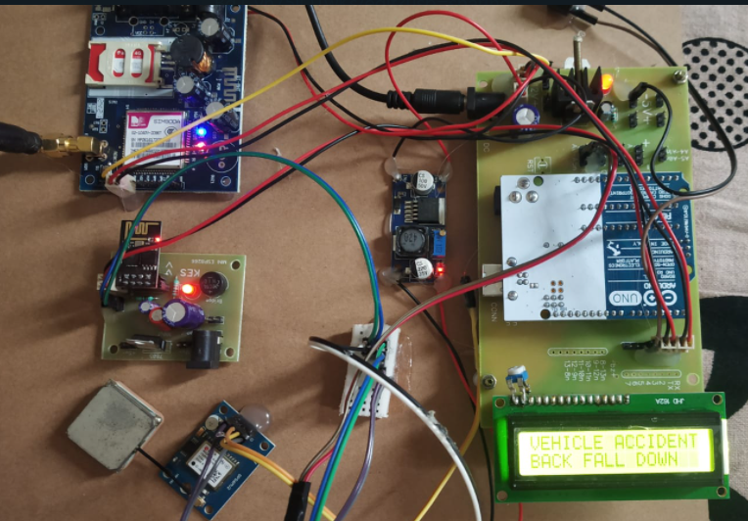

Slide 13
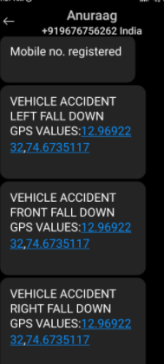
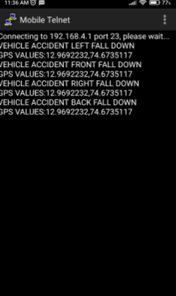

Slide 14

CONCLUSION
This project presents the automatic vehicle accident identification and alerting system using IOT. This design is the system which can detect the accidents in less time and sends the information to the concerned authorities. This project is user-friendly and reliable. The proposed method is highly beneficial to the automotive industry. In future, data logging and analysis can be implemented to monitor the traffic situations in various regions.

Slide 15

Scope for improvement
This model helps in finding the exact location of the accident and sends it to the respective mobile number we have given in the model. But this can be made further improved by
1.Creating a model which will send the message to the nearby police station and the hospital with ambulance availability.
2.A buzzer is being used to make a sound at the accident location to get to know about the accident in the nearby places.
3.Creating an app to organise and maintain the information for further medical care and necessary equipment facility.

Slide 16
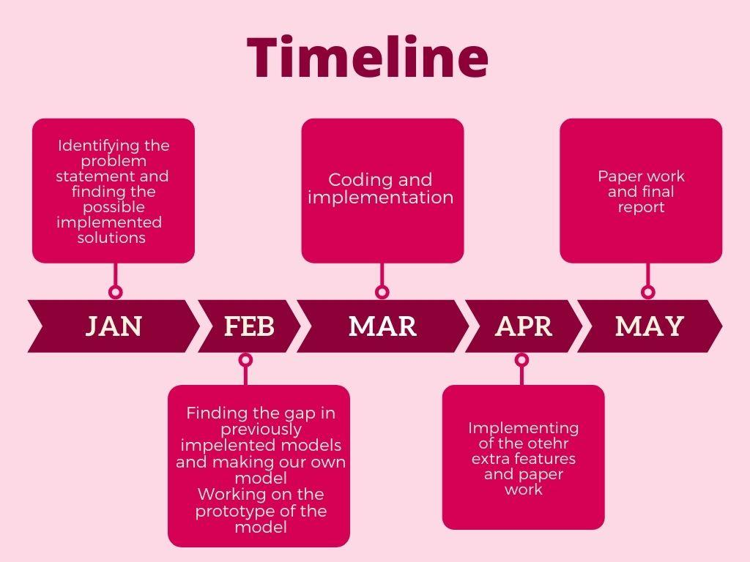
TIMELINE

Slide 17
REFERENCES
[1] World Health Organization Road Traffic Injuries Fact Sheet No 358, March 2013, Available from http://www.who.int/mediacentre/factsheets/fs358/en/ [Last accessed on 2017 Dec 16]
[2] National statistics of road traffic accidents in India, September 2013, Available from http://www.jotr.in/article.asp?issn=0975- 7341;year=2013;volume=6;issue=1;spage=1;epage=6;aulast= Ruikar /[Last accessed on 2017 Dec 16]
[3] “Vehicle Accident Detection And Reporting System Using Gps And Gsm.” by AboliRavindraWakure, ApurvaRajendraPatkar, IJERGS April 2014.
[4] Tanushree Dalai, "Emergency Alert and Service for Automotives for India", International Journal of Advanced Trends in Computer Science and Engineering (IJATCSE) Mysore India, vol. 2, no. 5, pp. 08-12, 2013.
[5] Amit Meena, Srikrishna Iyer, Monika Nimje, Saket JogJekar, Sachin Jagtap, Mujeeb Rahman, "Automatic Accident Detection and Reporting Framework for Two Wheelers", IEEE International Conference on Advanced Communication Control and Computing Technologies (ICACCCT), pp. 962-967, May 2014

Slide 18
[6] Vikas Desai, “Design and Implementation of GSM and GPS Based Vehicle Accident Detection System”, IJIT, Vol 01, Issue 03,pp. 1- 4,2013.
[7] C.Prabha, R.Sunitha, R.Anitha, “Automatic Vehicle Accident Detection and Messaging System Using GSM And GPS Modem”, IJAREEIE, Vol. 3, Issue 7, pp. 1-5, 2014.
[8] Vikram Singh Kushwaha, Deepa Yadav, “Car Accident Detection System using Gps, Gsm and Bluetooth” in IJERGS May-June 2015.
[9] AboliRavindraWakure,ApurvaRajendraPatkar, “Vehicle Accident Detection and Reporting System using Gps And Gsm.”, IJERGS, Vol 10,Issue 4,pp.-25- 28, April 2014.
[10] N. Watthanawisuth, “Wireless Black Box using MEMS Accelerometer and GPS Tracking for Accidental Monitoring of Vehicles”, IEEE conference in Jan, 2012.
[11] Hoang Dat Pham, “Development of vehicle tracking system using GPS and GSM modem” IEEE conference in Dec, 2013.
[12] Rashida Nazir, Ayesha Tariq, Sadia Murawwat, Sajjad Rabbani,”Accident Prevention and Reporting System using GSM (SIM 900D) and GPS (NMEA 0183)”, Int. J. Communications, Network and System Sciences, 2014, 7, 286-293 Published Online August 2014.

